Slide 1
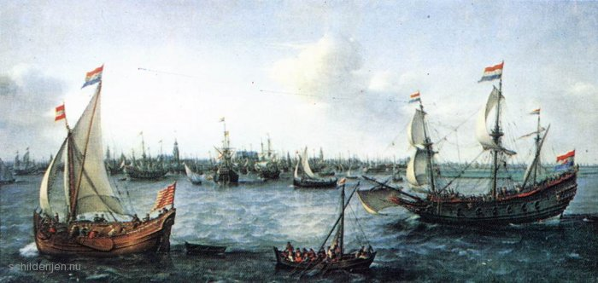
Quiz
Right or wrong!
Make teams;
Choose wich statement is wrong to earn points;
Team with most points wins!

Slide 2
Statement 1 (2.2 – trade)
Thanks to the mother of all trades, the Republic gained enough food to let farmers make products to sell on the market. This is called; commercial agriculture.
Thanks to the Mediterannean trade, the Republic gained enough food to let farmers make products to sell on the market. This is called; commercial agriculture.

Slide 3
Statement 2 (2.2 - cause)
If the Spanish had not taken Antwerp, trade would not have increased in the Republic.
Many merchants immigrated to Amsterdam because of the staple market, thats why the trade increased.

Slide 4
Statement 3 (2.2 - invention)
Because of the Dutch “fluytships” the Mediterranean trade increased and became more profitable.
The Dutch invention of the sawmill increased the production of planks, making it possible to build more “fluytships”

Slide 5
Statement 4 (2.3 – VOC)
Because of the Mediteranean trade, several economies were linked together, thus creating a world economy
The trade with the Mediteranean, europe and the Baltic is called the triangular trade.

Slide 6
Statement 5 (2.4 – Golden Age)
Because scientists started believing the Ancient texts again, the scientific revolution started.
Tolerance with limitations means that people were allowed to criticise the bible, but only so far.

Slide 7
Statement 6 (2.4 – Golden Age)
Because people were rich the demand for art grew. This sparked the start of the Golden Age for Dutch artists.
Trade gave much insight into animals and plants across the world, confirming what was written in the Bible.

Slide 8
Statement 7 (2.5 - Politics)
Thanks to the co-optation system, the important jobs were distributed amongst regents.
In the Dutch Republic, every province had just as much to say in the States-General.

Slide 9
Statement 8 (2.5 – Year of Disasters)
Because of year of disasters, England wanted to help the Dutch Republic.
The Brothers de Witt were blamed for the year of disasters, wich ultimately cost them their lives.

Slide 10
Statement 9 (2.6 – Monarchies)
During the forming of states, creating Monarchies, kings wanted to stop the creation of central administration.
Monarchs let cities pay taxes to pay for civil servants and armies. This increased their power.

Slide 11
Statement 10 (2.6 – Absolutism)
The Dutch republic is a great example of absolutism
Louis the XIV wanted everyone to have the same faith and made standing army of 400.000 men to enforce his will. This gave him total control of his country.
Peter the Great of Russia tried to make his country more democratic. This is called absolutism

Slide 12
Bonus Questions
2 minutes to prepare:
Explain the term Mercantalism
Government takes measures to influence trade. – 1 Point
Explain wich province was the most powerfull and why
Holland, they paid 60% of all expenses – 1 Point
What was decided in the Synod of Dordrecht?
The church doctrine was recorded more precisely – 0,5 points It was decided to translate the Bible in dutch into the “Statenbijbel” – 0,5 points
What were “voorcompagnies”?
Companies founded in Holland and Zeeland to conduct trade. -0,5 points They later fused and became the VOC – 0,5 points

